Slide 1

CSE 302:COMPUTER NETWORKS
IMPROVED ENCRYPTED IMAGE STEGANOGRAPHY ON CLIENT-SERVER IN JAVA
Presented By
124157042 - PESHWAR RAJESH,
Guide Name: Dr. R. Kavitha, CSE/SoC, SASTRA University
Presentation Date-13 December 2022

Slide 2
Points to be Discussed
1)Introduction
2)How does my project Work?
3)Existing Solutions : A Literature Survey
4)System Configurations
5)Project Progress
6)Sample I/O of the Project
7)Why my project?
8)Bibliography

Slide 3
1)Introduction
In our everyday life,we use chat applications like Whatsapp,Telegram,messenger and so on! It has become our Go-To tool for Both official and unofficial communication.We always want to Keep our messages secret from prying eyes in some form of encryption,which is why I wanted to Implement one of the Most Hybrid Encryptions- ”Steganography” in the form of a Chat application.
The technology has become so advanced and our topmost priority is to secure data. Nowadays data sharing is increasing rapidly as there are thousands of messages and large number of data transmission taking place on the internet every day from one place to another. The secured data transmission is the primary concern of the sender, which is to protect data and it is really important to transmit our message in a secret way that only the receiver can able to understand.Steganography literally means hiding data in plainsight.

Slide 4
2)How does my project Work?
I have built this project based on Java that enables a Client to connect to a Server for Chatting using Image Steganography.
The Server generates an OTP on connecting with the Client for authorization.
To encode message we use the embed button and select the picture and message and send it.
To read any message, the Client will select a message and click on the Decoder and then, will be able to decode the image using the OTP provided.

Slide 5
3)Existing Solutions : A Literature Survey
https://www.emertxe.com/embedded-systems/c-programming/c-projects/lsb-image-steganography/
https://stackoverflow.com/questions/15651567/steganography-in-c
https://www.geeksforgeeks.org/image-based-steganography-using-python/
https://ieeexplore.ieee.org/document/9335027

Slide 6
4)System Configurations
Server Side:-
Hardware configuration:Any PC
Software configuration: JAVA
Network:Wired/Wireless
Interface:Graphical user interface(GUI) using Java string/awt
Protocol:TCP/IP
Client Side:-
Hardware configuration:Any PC
Software configuration: JAVA
Network:Wired/Wireless
Interface:Graphical user interface(GUI) using Java string/awt
Protocol:TCP/IP

Slide 7
5)Project Progress
The Project was successfully completed to a 100%
Some of the salient features are:
1)Implementation of OTP
2)GUI based for easy use
3)Security of the messages sent

Slide 8
RFC number
Protocol 9293-TCP 791-IP
TCP-It is a reliable protocol, ensures that the data reaches intended destination in the same order it was sent. is connection oriented, provides error-checking and recovery mechanism, provides end-to-end communication, provides flow control and quality of service.
IP-The Internet Protocol is responsible for addressing host interfaces, encapsulating data into datagrams (including fragmentation and reassembly) and routing datagrams from a source host interface to a destination host interface across one or more IP networks.

Slide 9
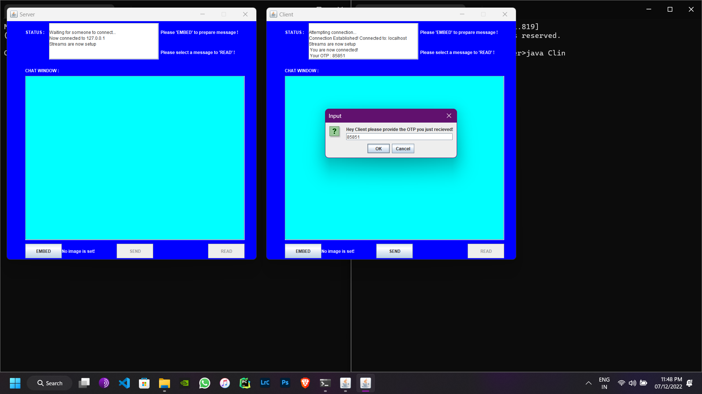
6)Sample I/O of the Project
INITIAL SCREEN WHERE OTP IS REQUESTED UPON LOGIN BY 2 PARTIES

Slide 10
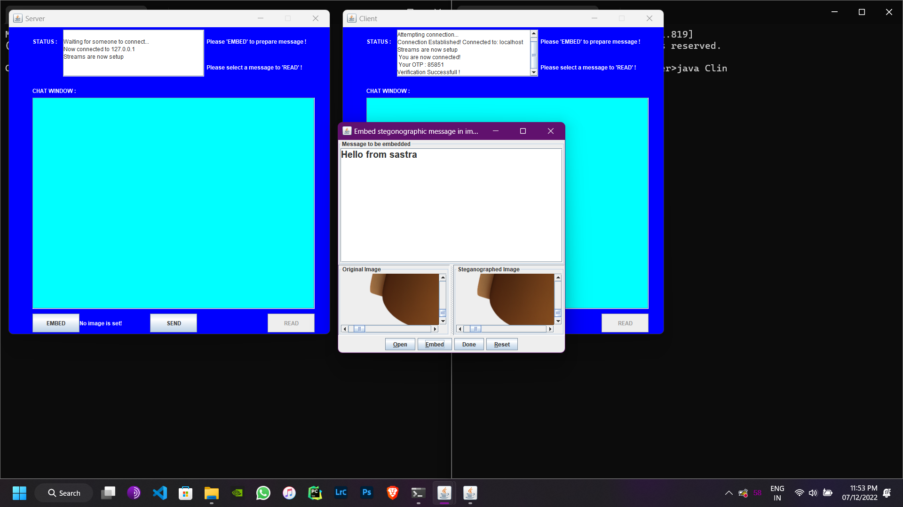
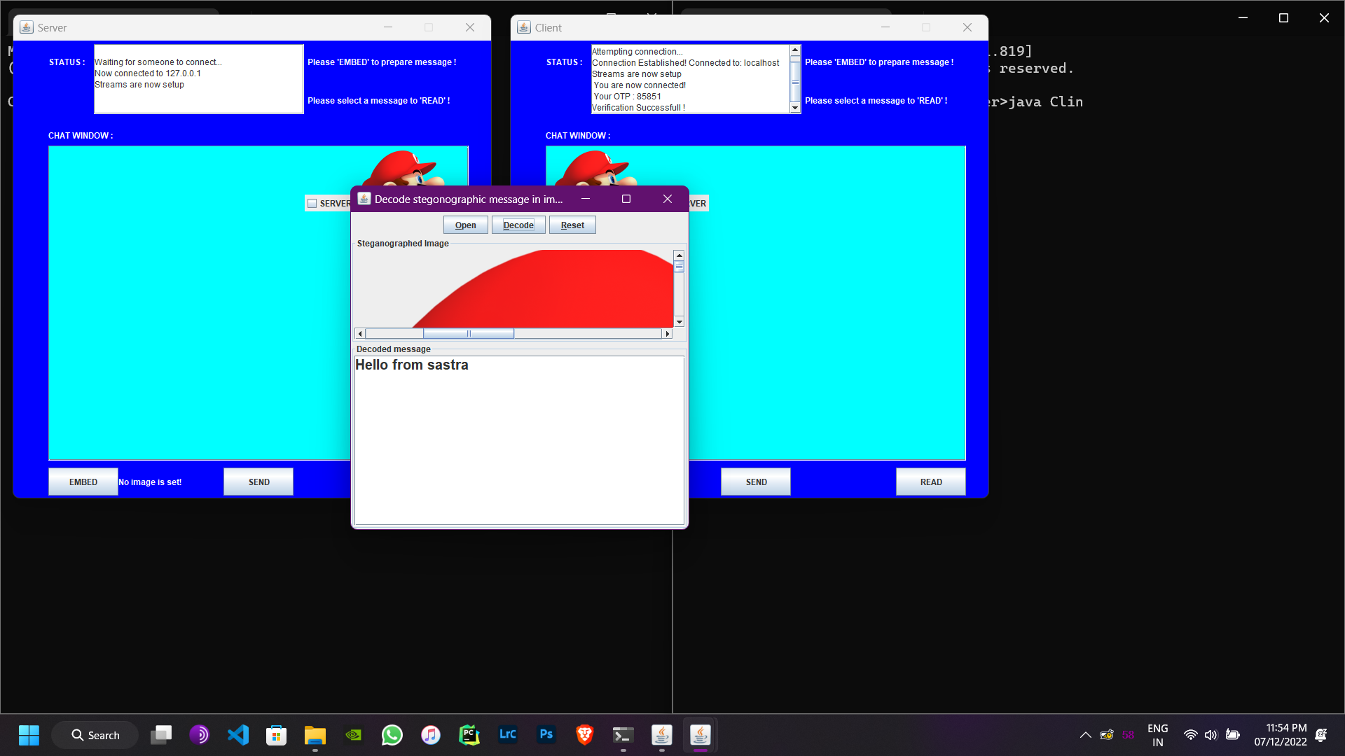
ENCODING & DECODING

Slide 11
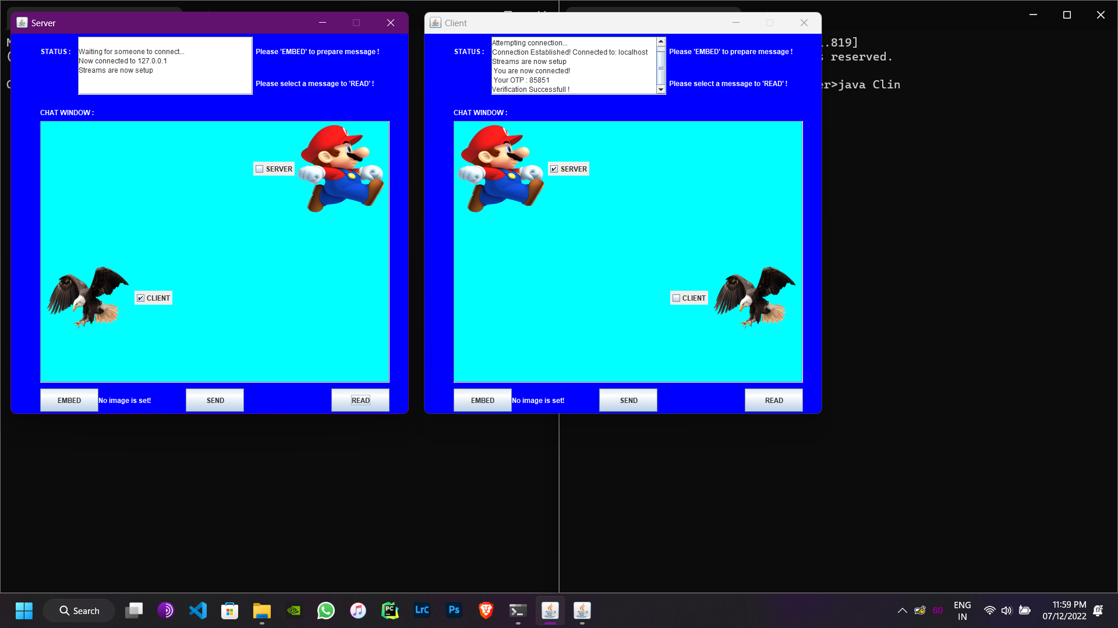
FINAL CHAT UI

Slide 12
7)Why my project?
Steganography is the nascent stage of development,The world is evolving Technology is evolving very fast too! Everyone wants their own Privacy and in this world of hackers,one must know how to hide their secret message in plain sight and share it to only the concerned person.So steganography is like an ideal tool for such people
Steganography has the real potential for the safe transmission of data in this hacker’s world when utilized in a proper manner.The average encryption is easily tapped into at times by unauthorised persons so this type of encryption may bring in peace for such individuals.
Which is why I have tried this Steganography based Server Client Chat with OTP authentication.

Slide 13
8)Bibliography
REFERENCES
• Gowda,S.N and Sulakhe, s., 2016,April. Block based least significant bit algorithm for image steganography. Annual Int’l conference on intelligent computing, computer science and information systems (ICCSIS-16).
• http://en.wikipedia.org/wiki/steganography
• Article by AshwinGoel for image based steganography using python, improved by PratikBhattacharjee2 and AshwinGoel.
• https://www.geeksforgeeks.org/image-steganography-in-cryptography/
Reference Books
• James F Kurose, Keith W Ross Computer Networking A Top Down Approach

